Slide 1

ELECTROMAGNETIC RELAYS

Slide 2
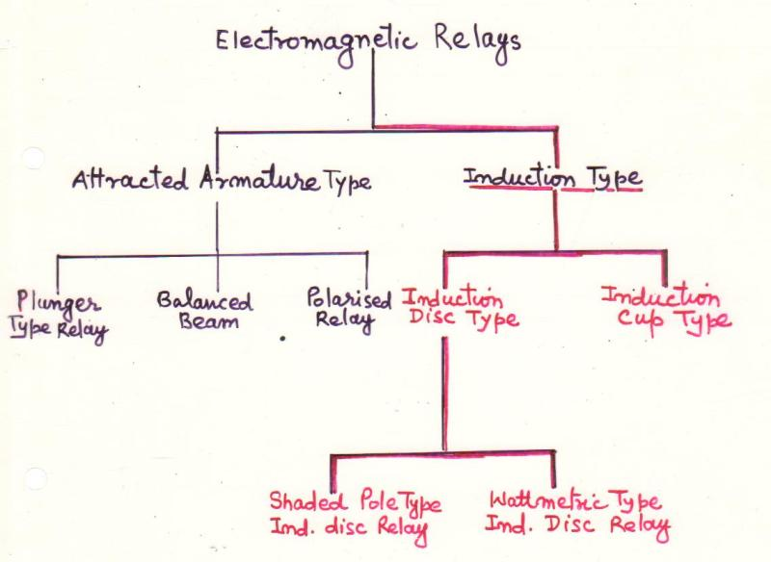

Slide 3
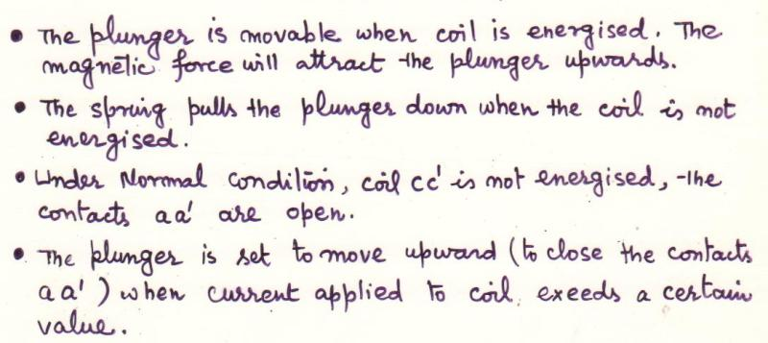
PLUNGER TYPE OF RELAY

Slide 4
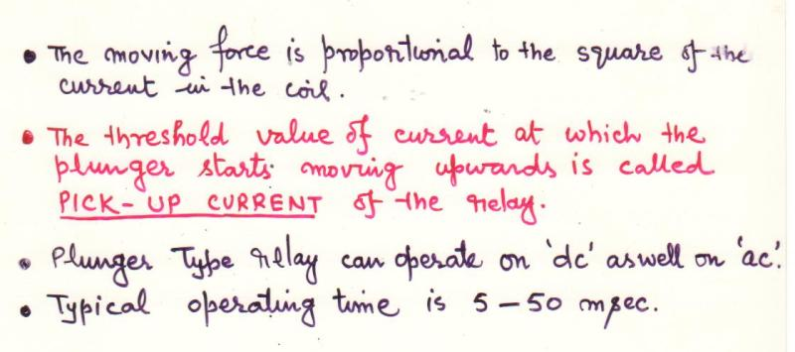

Slide 5
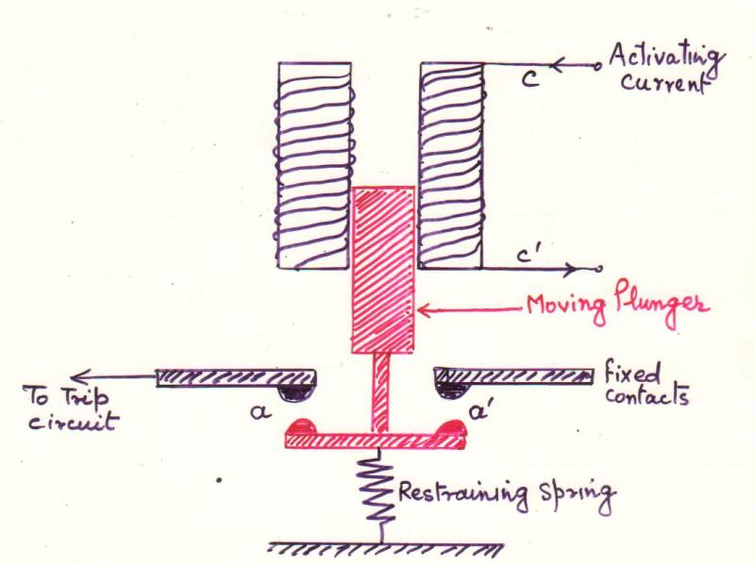
PLUNGER TYPE OF RELAY

Slide 6
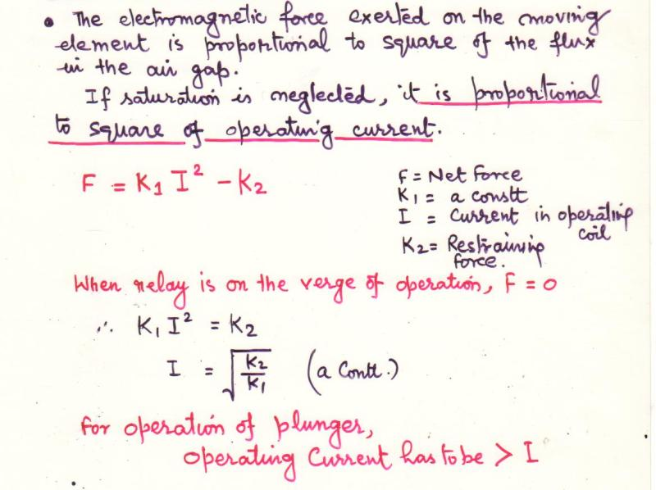
OPERATING PRINCIPLE

Slide 7
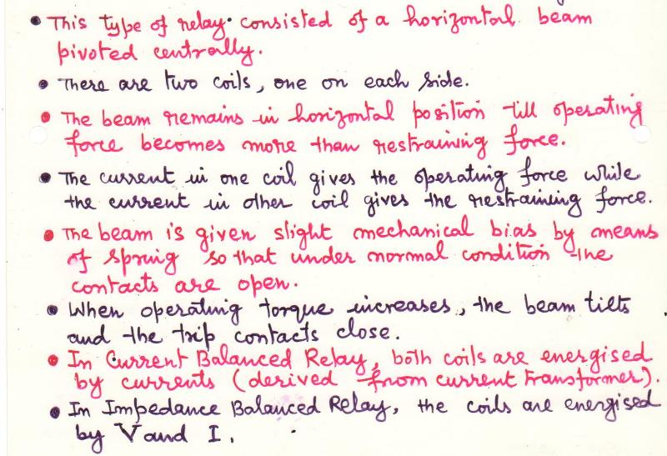
BALANCED BEAM TYPE

Slide 8
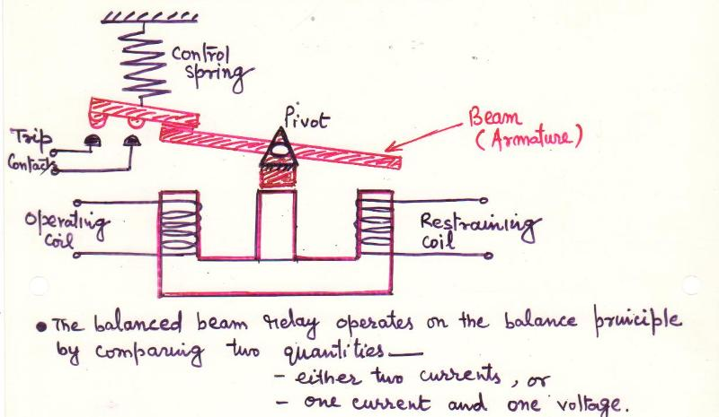

Slide 9
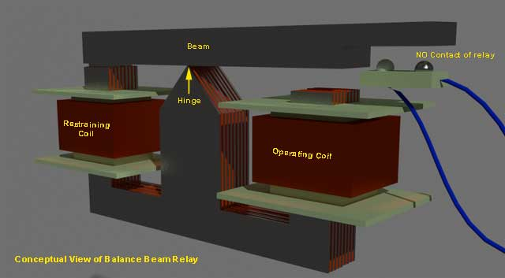

Slide 10
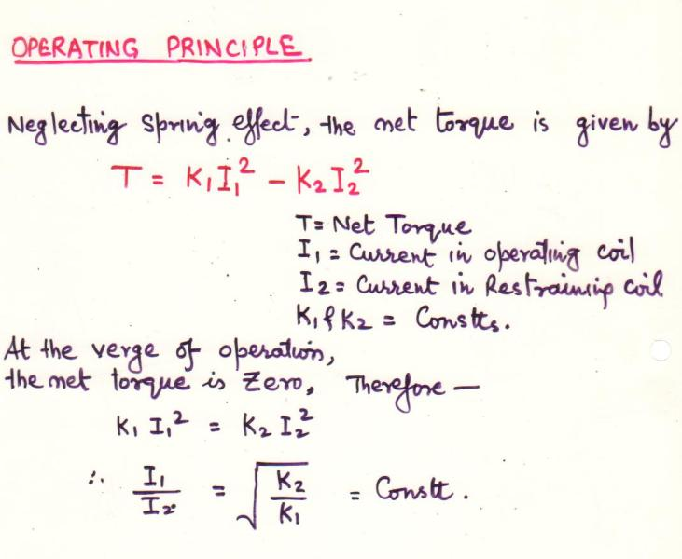
OPERATING PRINCIPLE

Slide 11
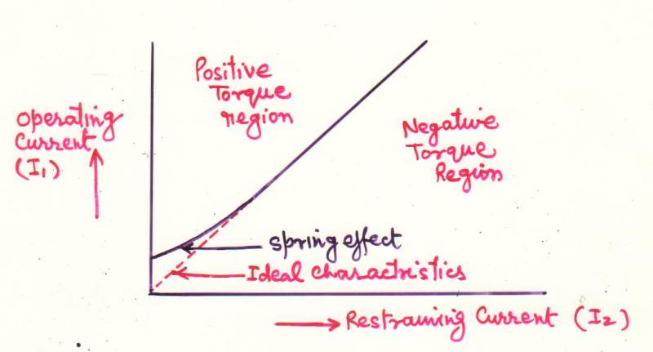

Slide 12
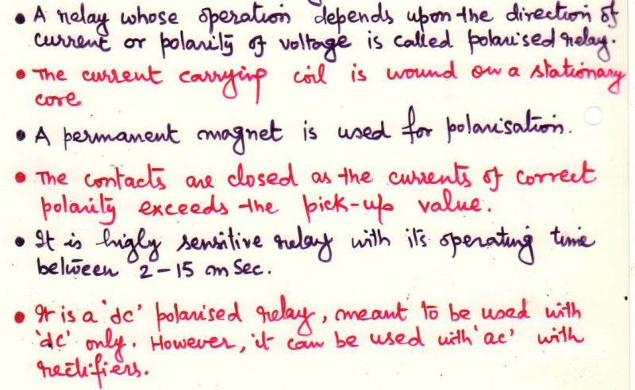
POLARIZED RELAYS

Slide 13
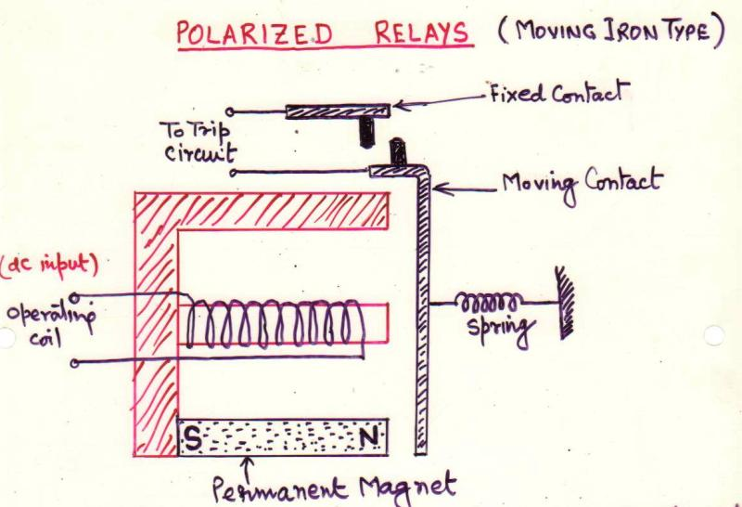

Slide 14
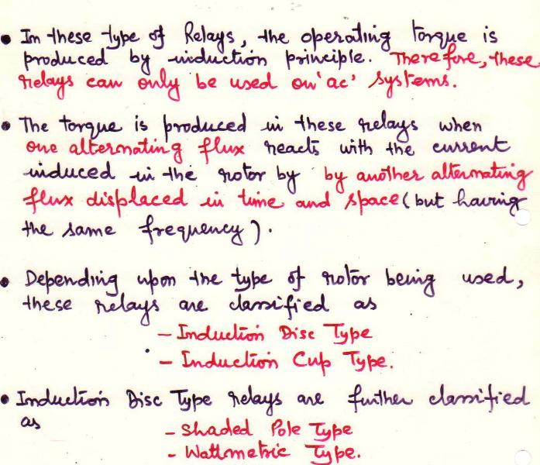
INDUCTION TYPE RELAYS

Slide 15
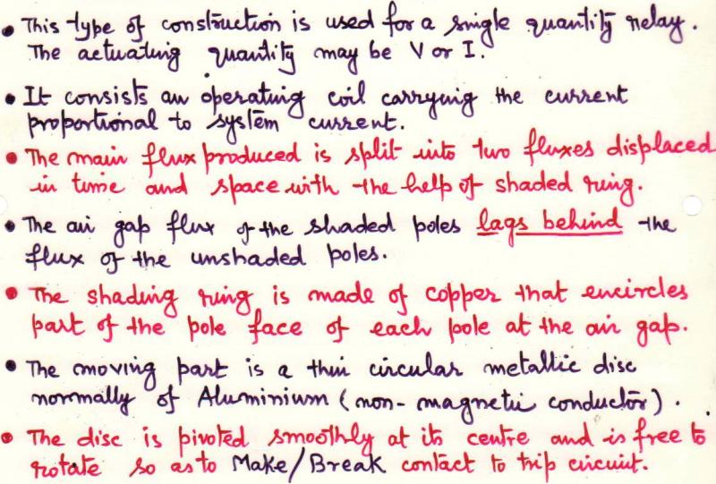
SHADED POLE TYPE

Slide 16
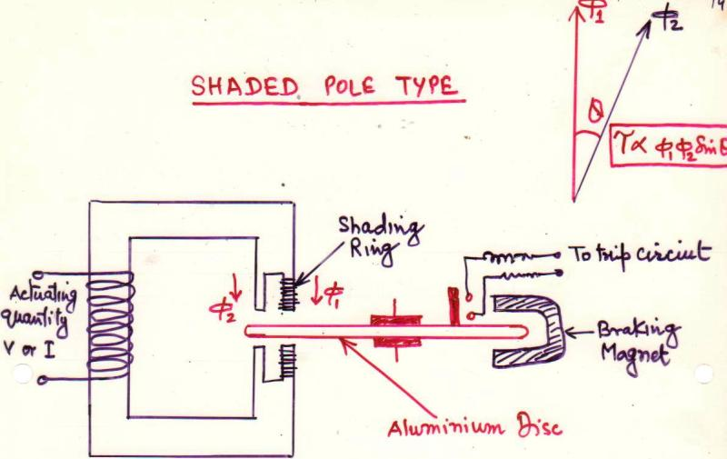

Slide 17
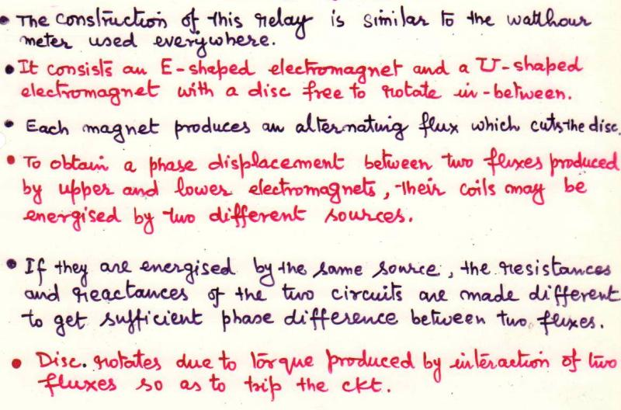
WATTMETRIC INDUCTION DISC RELAY

Slide 18
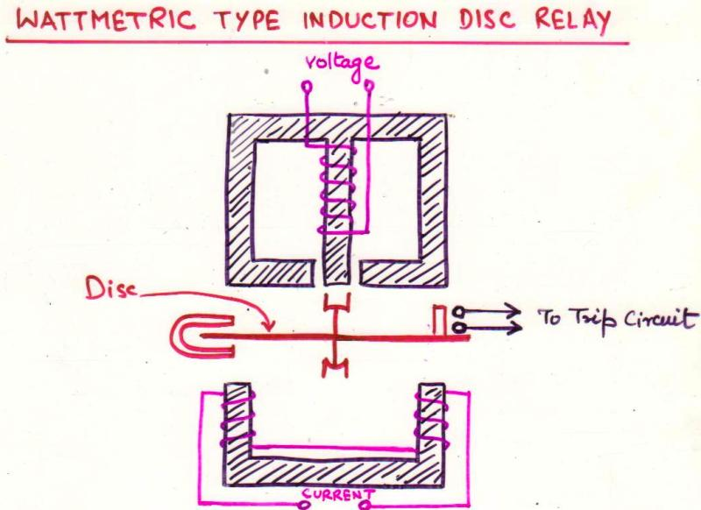

Slide 19
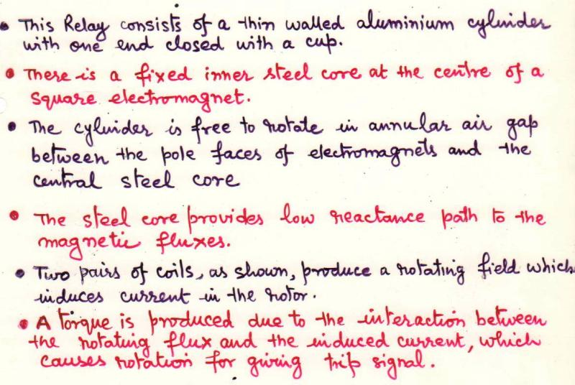
INDUCTION CUP TYPE RELAY

Slide 20
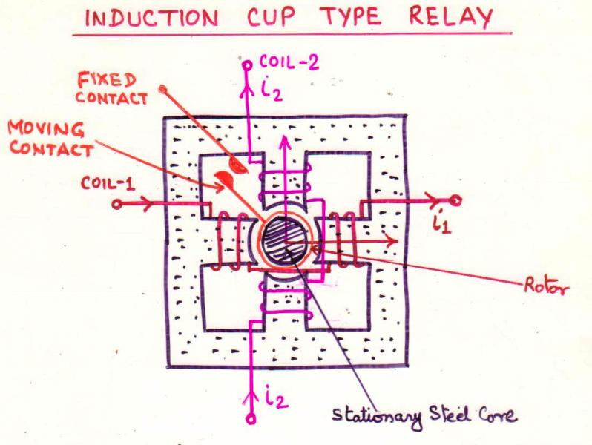

Slide 21
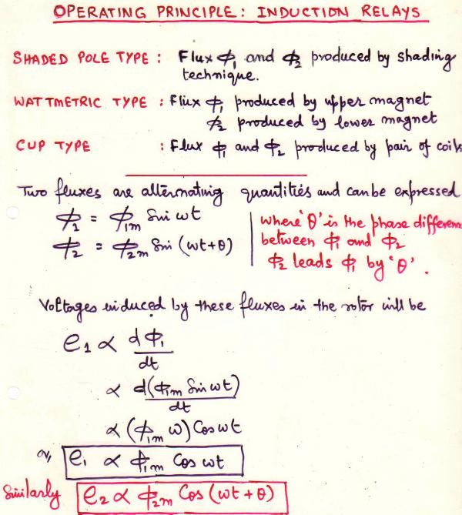

Slide 22


Slide 23
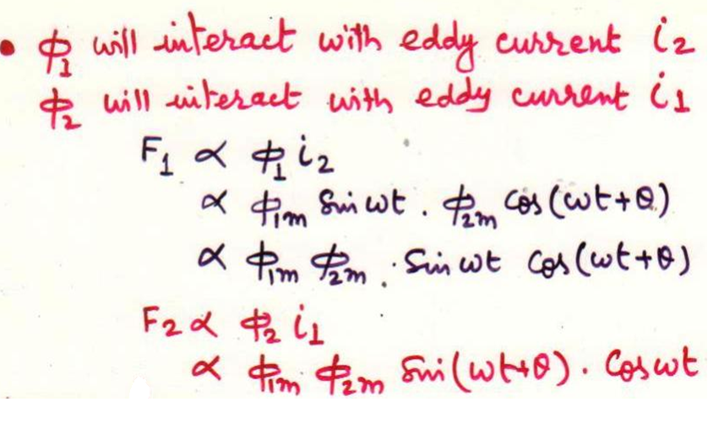

Slide 24
